Slide 1
data centers’ architecture and routing
Version | 3.1
Author(s) | L. Ariemma, G. Di Battista, M. Patrignani, M. Scazzariello, T. Caiazzi
E-mail | contact@kathara.org
Web | http://www.kathara.org/
Description | Data Centers’ Routing: Multipath, Fat-Trees, BGP, VXLAN

Slide 2
copyright notice
all the pages/slides in this presentation, including but not limited to, images, photos, animations, videos, sounds, music, and text (hereby referred to as “material”) are protected by copyright
this material, with the exception of some multimedia elements licensed by other organizations, is property of the authors and/or organizations appearing in the first slide
this material, or its parts, can be reproduced and used for didactical purposes within universities and schools, provided that this happens for non-profit purposes
any other use is prohibited, unless explicitly authorized by the authors on the basis of an explicit agreement
this copyright notice must always be redistributed together with the material, or its portions

Slide 3
Multi-Path
in a nutshell

Slide 4
Multi-Path
data center architectures allow to establish several paths between pairs of nodes
Multi-Path routing is used to
distribute and balance the traffic among different paths
increase the fault tolerance

Slide 5
Multi-Path
allows to have more than one next-hop for the same prefix in the FIB (Forwarding Information Base)
needs kernel support
the main OSes and routers support it
different usage policies can be applied
packets of the same flow should use the same path
reordering packets is computationally heavy

Slide 6
Equal-Cost Multi-Path (ECMP)
a specific approach to Multi-Path
exploits paths to the same destination that have the same “cost”
e.g., same IGP cost, same number of hops
allows to choose among the available paths in a uniform way
often used in Fat-Tree data centers
we’ll get there in a couple of slides

Slide 7
how packets are forwarded
for each packet, the kernel decides the FIB entry to be used
different policies are allowed
hash-based policy
Layer-3 hash (src IP, dst IP)
Layer-4 hash (src IP, dst IP, src port, dst port, protocol)
round-robin

Slide 8
Hyper-scale Data Centers
main concepts

Slide 9
a high-level architecture
Internet connections
multiple redundant high-speed fiber optic links
fabric
infrastructure designed to transport packets between servers and between servers and Internet
server farm
host applications and services

Slide 10
a high-level architecture
Internet
data center fabric
server farm

Slide 11
fabric architecture
why Fat-Trees?

Slide 12
overview – fabric architecture
real-life data centers
service model
data center network
traffic flow directions
requirements
components
topologies

Slide 13
real data center information – figures
links are fiber optic links
each link in the fabric is at least at 100Gb/s
each switch is at least of 64 ports
about 5,000 switches/routers
about 60,000 servers

Slide 14
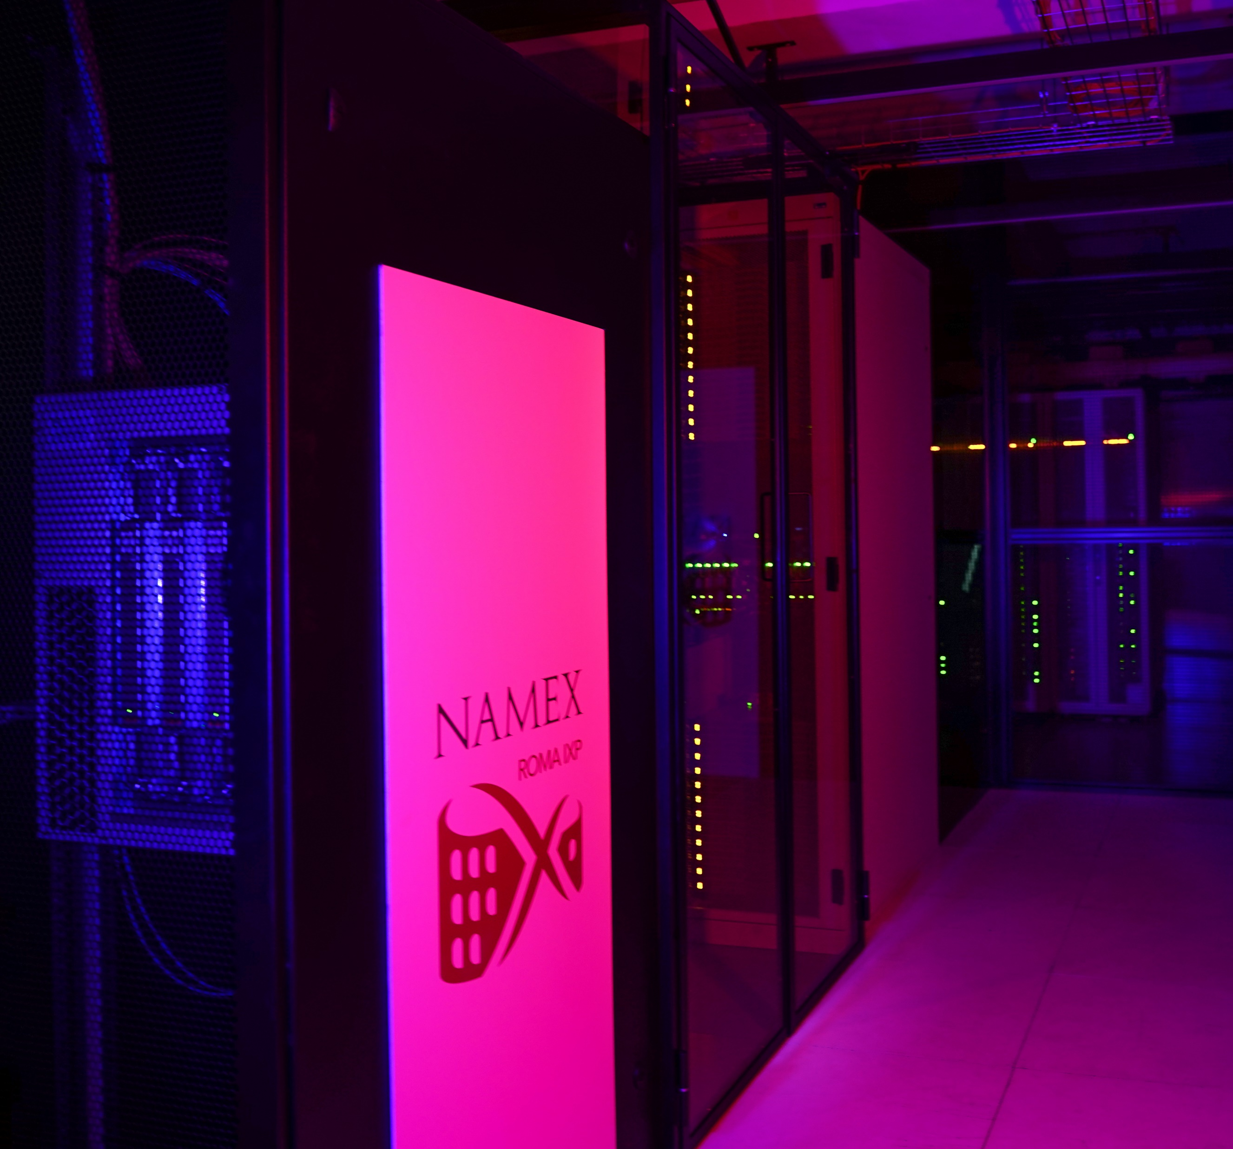
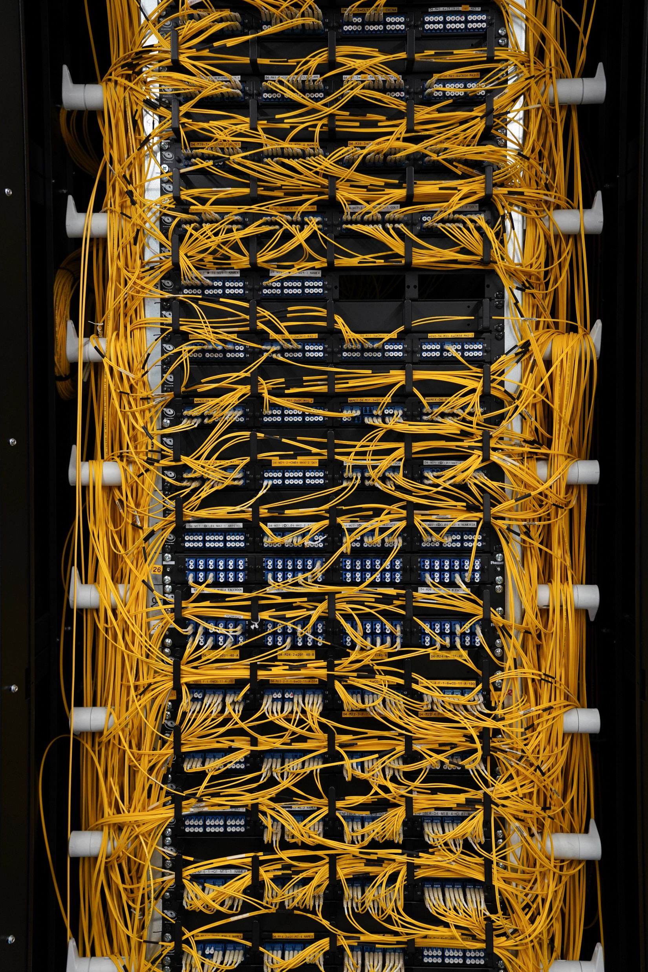

Slide 15
data center failures – yearly report
statistics by Google (2008) in a portion of data center composed of 1,800 servers:
1,000 individual machine (switch/router or server) failures
thousands of hard drive failure
1 power distribution unit failure
down for 500/1000 machines for 6 hours
1 cluster complete rewire (not simultaneously)

Slide 16
data center service models
three different service models
on-premise data centers
built, owned and operated by a company
often housed in a building of the organization
colocation data centers
built and owned by a company that rents space within the data center to other companies
the hosting company manages the infrastructure (building, cooling, bandwidth, security etc.)
the hosted companies provides the components, including servers, storage, and firewalls
cloud data centers
applications and data are hosted by a cloud service provider such as Amazon Web Services (AWS), Microsoft Azure, and Google Cloud Platform (GCP)

Slide 17
traffic flows inside a data center
two types of flows can be identified
traffic exiting or entering the data center
also called “north-south traffic”
data sent/received via Internet
server-to-server communications
also called “east-west traffic”: in data center schemata servers are typically drawn side-by-side
primarily, supports micro-services and distributed architectures

Slide 18
traffic flows inside a data center
north-south traffic
Internet
data center fabric
server farm
east-west traffic

Slide 19
data center network requirements
support high-bandwidth server-to-server communication
applications that rely on cluster computations, such as Hadoop or Spark, can involve hundreds or thousands of servers
customer’s containers/virtual machines (VMs) are distributed across multiple servers but need to communicate seamlessly
microservice architectures heavily rely on server-to-server communication
scale
data centers range from a few hundred to a hundred thousand servers in a single physical location
resilience
data center applications are designed to work in presence of failures

Slide 20
data center network components
data center nodes can be connected by using two network component types
specialized hardware
proprietary hardware that can scale to clusters of thousands of nodes with high bandwidth
e.g., Google Jupiter and InfiniBand switches
expensive option
commodity switches and routers
cheap option
widely adopted, this is the option we consider in the following

Slide 21
topology requirements
scalability
it should be possible to expand the data center
in other words, it must be possible to buy and deploy hardware similar to the one already deployed
bandwidth
hosts in the fabric should communicate with each other using the full bandwidth of their NICs

Slide 22
data center network topologies
several topologies have been proposed
Clos
Fat-Tree
VL2
Jellyfish
Xpander
DCell
...

Slide 23
Clos topology
invented by Edson Erwin in 1938 to address scalability issues in telephone networking
formalized by Charles Clos in 1953
the original problem was allowing N contemporary connections from N input lines to N output lines without using a single crossbar switch

Slide 24
Fat-Tree topology
Fat-Trees were originally introduced by Charles Leiserson in 1985
the Fat-Tree is a special case of a Clos
typical Fat-Tree architectures today consist of three level of nodes (switches/routers)
high redundancy
constant bisection of the available bandwidth
typically, nodes have the same characteristics
easier to stock spare equipments

Slide 25
Fat-Tree parameters
the Fat-Tree is a modular topology
two parameters define a Fat-Tree
radix of the nodes (even number, denoted by 2K)
number of available ports
redundancy factor (denoted by R)
usually, if the radix of a node is 2K it has K connections towards the north and K connections towards the south
different choices are possible, but not considered here

Slide 26
Fat-Tree nodes
Leaf
node connected to the server farm
Spine
node north of Leaves and south of ToF nodes
Point of Delivery (PoD)
set of fully interconnected Leaves and Spines
Top of Fabric (ToF)
set of top nodes that provide inter-PoD communication

Slide 27
an example of Fat-Tree: FT(K=2,R=2)
ToF (Top of Fabric)
aggregation layer
Spine
PoD (Point of Delivery)
Leaf
Server Farm

Slide 28
redundancy factor (R)
number of links between a ToF node and a PoD
allow to connect more PoDs reducing the redundancy
R = 2
R = 1
Server Farm
Server Farm

Slide 29
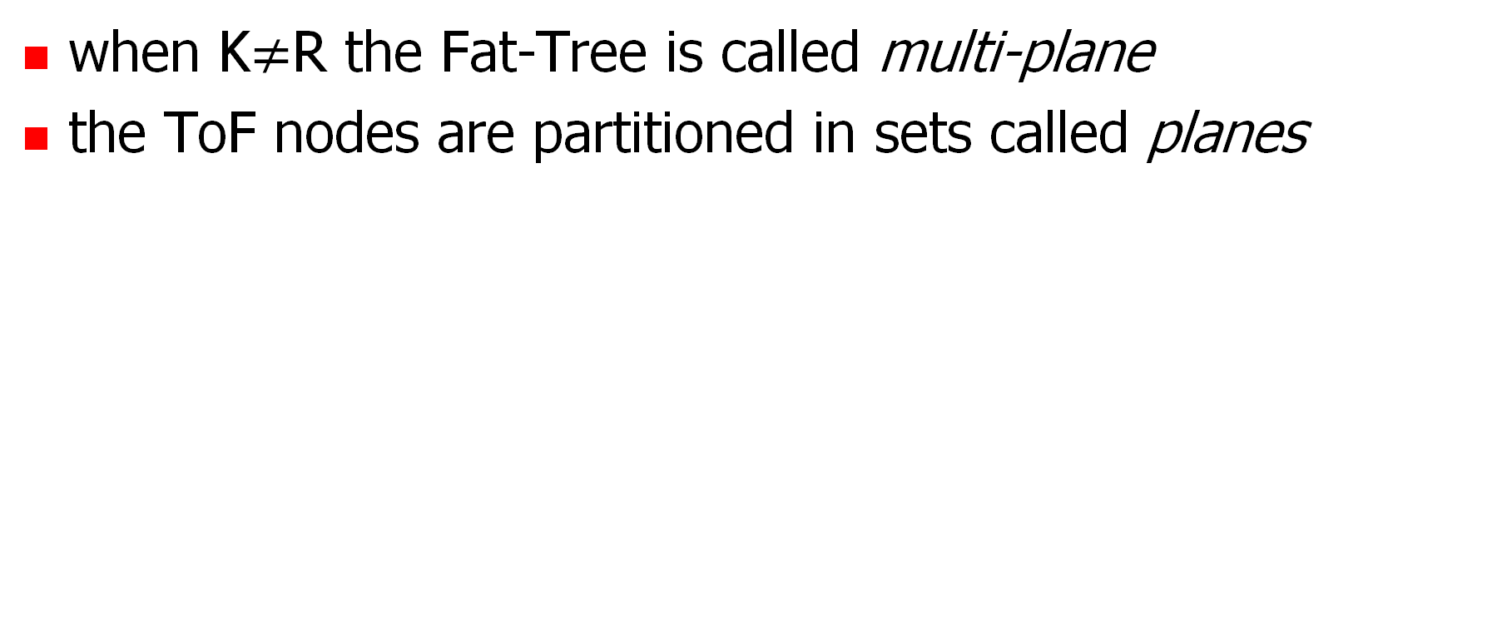
multi-plane Fat-Tree
when K$≠$R the Fat-Tree is called multi-plane
the ToF nodes are partitioned in sets called planes
Plane A
Plane B
Server Farm

Slide 30
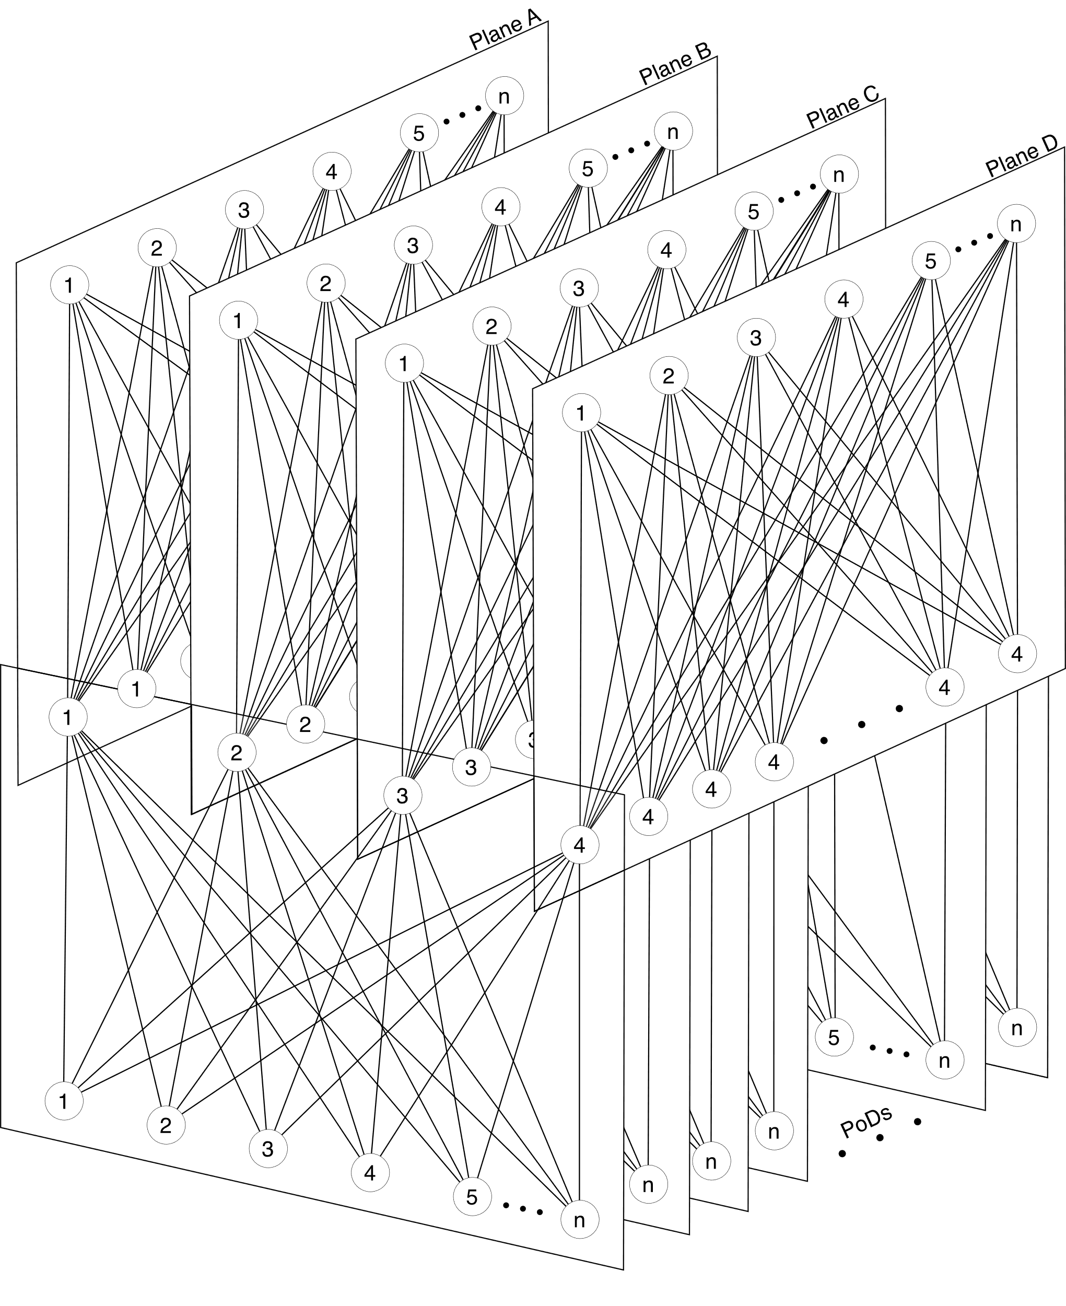
example of a multi-plane Fat-Tree
diagram from the IETF RIFT Draft

Slide 31
connecting a Fat-Tree to the Internet
two strategies
usage of a dedicated PoD
usage of ToFs
Internet
Internet

Slide 32
routing in Fat-Trees
why BGP?

Slide 33
overview – routing
why routing and not switching?
the choice of the routing protocols
why using BGP in Fat-Tree data centers?
inter-domain routing VS data center routing
BGP in the data center

Slide 34
why routing and not switching?
 | Pros | Cons
Switching (L2) | No configuration needed | STP protocol has no multipath support Using VLANs for load balancing is tricky Broadcast traffic flooding the network
Routing (L3) | Multipath support | Need of routing protocols Complex configuration Need of automating the configuration

Slide 35
choosing a routing protocol
there are many possibilities, among them
a classical IGP protocol (e.g., OSPF, IS-IS)
BGP (most used in Hyperscale data centers)
RIFT (Routing In Fat-Trees)
Under standardization at IETF
Designed for Fat-Trees topologies
OpenFabric
IS-IS variant created for Clos topologies
SDN Protocols

Slide 36
why using BGP in Fat-Tree data centers?
BGP has several stable and robust implementations, even open-source
e.g., FRRouting, Quagga
BGP generates less flooding than common IGPs (IS-IS, OSPF, etc.)
if a received update does not change the best route, a BGP speaker does not propagate the update
BGP natively supports ECMP (Equal-Cost Multi-Path)
Fat-Trees have many paths with the same length

Slide 37
why using eBGP? (and not iBGP)
the most obvious choice would be to use iBGP since the data center networks is under the same administration
however, eBGP is always used because
eBGP is easier to setup, no need for IGP
with iBGP, the IGP would compute routes
iBGP multipath support has some limitations
can be overcame, but it is complex

Slide 38
inter-domain routing VS DC routing
inter-domain routing | data centers’ routing
the internet has relatively sparse connectivity | data centers’ networks have very dense connectivity
stability is preferred over quick convergence | quick convergence is preferred over stability
the aim is computing a single best path for each destination | the aim is computing multiple paths to each destination

Slide 39
BGP in the data center
BGP was primarily devised for inter-domain routing
default configurations are not suitable in a data center
needs some tweaks described in RFC-7938
AS numbers assignment
ECMP policy relax
timer adjustment

Slide 40
AS numbers assignment
global ASNs are not used in the data center
they can be misleading
because operators associate them with names
they are dangerous
an accidental leakage of the internal BGP notifications to the internet may be disruptive
private ASNs are generally used
the 2-byte ASNs allow only 1,023 private ASes in the range 64512–65534
the 4-byte ASNs support almost 95 million private ASes in the range 4,200,000,000–4,294,967,294

Slide 41
ASes and routers
the most obvious choice would be assigning a different ASN to each node
however, this approach would lead to BGP path exploration issues

Slide 42
BGP path exploration
immediately after a fault there is a transient period when inconsistent AS-paths are propagated in the network
routers have plenty of alternatives and jump from one to another before all alternatives are withdrawn
each best route change is propagated again by the routers
lots of useless BGP updates are transmitted
since data centers’ topologies are dense and hence have a lot of cycles this problem has to be addressed

Slide 43
the problem of BGP path exploration
because of the adopted AS scheme several fake routes could be possible during path exploration
*>193.204.0.0/15 [L2]
*>193.204.0.0/15 [L2]
[L1,S1,L2]
*>193.204.0.0/15 [L2]
S1
S2
[L2]
[L1,S1,L2]
*>193.204.0.0/15 [S1,L2]
*= [S2,L2]
[S1,L2]
[L2]
[S2,L2]
X
L1
L2
193.204.0.0/15

Slide 44
the ASes scheme of choice
each Leaf is a different AS
the Spine nodes of each PoD belong to the same AS
the ToF nodes of the same plane belong to the same AS
BEWARE: there are NO iBGP peerings

Slide 45
the ASes scheme of choice – multi-plane
Plane A
Plane B
Server Farm

Slide 46
multiple paths between Leaves
the adopted AS scheme allows for multiple paths between pairs of Leaves
in a FT(K=2,R=2) only two paths are possible between two Leaves of the same PoD
they don’t leave the PoD

Slide 47
multiple paths between Leaves
the adopted AS scheme allows for multiple paths between pairs of Leaves
in a FT(K=2,R=2) eight paths are possible between two Leaves of different PoDs

Slide 48
BGP and ECMP
BGP natively supports ECMP
by default, BGP considers two announcement of the same prefix “equal” if they are equal in each best-path selection criterion except for the last one
lowest router-id of the announcing peer
to enable multi-path, BGP requires that the AS-paths selected for multi-path match exactly
not just they have equal-length but equal AS numbers inside

Slide 49
BGP multi-path relax
when the AS_PATH lengths of different announcements for the same prefix are the same, the best-path algorithm skips checking for exact match of the AS numbers
this modification is often called “as-path multipath-relax”
different vendors may use different names
really needed for using dual attached servers and multi-plane Fat-Trees

Slide 50
tuning BGP timers
there are four main timers that are responsible for BGP behaviour
advertisement interval timer
keepalive timer
hold timer
connect timer

Slide 51
advertisement interval timer
announcements that need to be sent to a neighbor are bunched together and sent together only when the interval expires
then the timer is reset for that neighbor
the default value for eBGP is 30s
in interdomain routing this improves stability and reduces the number of multiple updates for the same prefix
in data centers is set to 0s
it is required for fast convergence

Slide 52
keepalive and hold timers
each BGP peer sends periodic keepalive messages to its neighbors according to the keepalive timer
when a peer doesn’t receive a keepalive for a period greater than the hold timer
the connection is dropped
all the announcements received are considered invalid
the peer tries to re-establish the connection
by default, the keepalive timer is 60s and the hold timer is 180s
in data centers timers of 3s and 9s are used, respectively

Slide 53
connect timer
when a connection to a peer fails, BGP waits for the connect timer expiration before attempting to reconnect
the connect timer by default is 60s
this can delay session re-establishment when a link recovers from a failure or a node powers up
in data centers it is set to 10s

Slide 54
automating the configuration
unnumbered interfaces
used to establish peerings specifying the interface name rather than the IP address and the remote AS number
peer groups
used to specify policies for groups of peers

Slide 55
connecting the servers
each Leaf announces its server’s prefix
IPs are assigned directly to the servers
Containers or VMs
Servers

Slide 56
disadvantages
containers/VMs share the same IP prefix of the server
no possibility to move containers between servers without IP remapping
tenants must follow the IP plan of the data center
cannot expose containers with custom IPs
there is no isolation between
the data center traffic and the tenants traffic
different tenants

Slide 57
basic Fat-Tree lab
hands on Kathará

Slide 58
lab pre-conditions
Linux and macOS
no specific requirement
Windows
WSL 2 does not support Multi-Path
need to fallback to Hyper-V Docker backend
open Docker Desktop and go to Settings (cog in the top-right corner)
unselect the “Use the WSL 2 based engine” checkbox
click “Apply & restart”
or create a VM with a Linux distribution

Slide 59
naming convention
tof_x_y_z
x: plane number
y: level, always 2
z: ToF number
spine_x_y_z
x: PoD number
y: level, always 1
z: Spine number
leaf_x_y_z
x: PoD number
y: level, always 0
z: Leaf number
server_x_y_z
x: PoD number
y: corresponding Leaf number
z: server number

Slide 60
lab topology
10.0.0.28/30
10.0.0.48/30
10.0.0.24/30
10.0.0.52/30
AS64518
10.0.0.20/30
tof_1_2_1
tof_1_2_2
10.0.0.56/30
10.0.0.16/30
10.0.0.60/30
G
H
Q
R
S
T
I
J
AS64514
AS64517
10.0.0.12/30
spine_1_1_1
spine_1_1_2
spine_2_1_1
spine_2_1_2
D
B
10.0.0.4/30
10.0.0.44/30
N
L
10.0.0.36/30
10.0.0.0/30
A
E
10.0.0.8/30
10.0.0.32/30
K
O
10.0.0.40/30
201.1.2.0/24
AS64512
AS64513
201.2.1.0/24
202.1.2.0/24
AS64515
AS64516
202.2.1.0/24
leaf_1_0_1
leaf_1_0_2
leaf_2_0_1
leaf_2_0_2
201.1.1.0/24
201.2.2.0/24
202.1.1.0/24
202.2.2.0/24
C
U
V
Z
M
F
P
W
server_1_1_1
server_1_1_2
server_1_2_1
server_1_2_2
server_2_1_1
server_2_1_2
server_2_2_1
server_2_2_2

Slide 61
ToF configuration example
bgpd.conf
router bgp 64518
timers bgp 3 9
bgp router-id 192.168.0.14
no bgp ebgp-requires-policy
bgp bestpath as-path multipath-relax
neighbor fabric peer-group
neighbor fabric remote-as external
neighbor fabric advertisement-interval 0
neighbor fabric timers connect 10
neighbor eth0 interface peer-group fabric
neighbor eth1 interface peer-group fabric
neighbor eth2 interface peer-group fabric
neighbor eth3 interface peer-group fabric
address-family ipv4 unicast
neighbor fabric activate
maximum-paths 64
exit-address-family
set keepalive and hold timers
BGP multi-path relax
create a peer-group
all peers of the group are eBGP. The remote ASN is inferred
set advertisement interval timer
set connect timer
add interfaces to peer-group for unnumbered peering
enable A.F. to peer-group
maximum Multi-Path possibilities

Slide 62
Spine configuration example
bgpd.conf – part 1
bgpd.conf – part 2
router bgp 64514
timers bgp 3 9
bgp router-id 192.168.0.5
no bgp ebgp-requires-policy
bgp bestpath as-path multipath-relax
neighbor TOR peer-group
neighbor TOR remote-as external
neighbor TOR advertisement-interval 0
neighbor TOR timers connect 10
neighbor eth0 interface peer-group TOR
neighbor eth1 interface peer-group TOR
neighbor fabric peer-group
neighbor fabric remote-as external
neighbor fabric advertisement-interval 0
neighbor fabric timers connect 10
neighbor eth2 interface peer-group fabric
neighbor eth3 interface peer-group fabric
address-family ipv4 unicast
neighbor fabric activate
neighbor TOR activate
maximum-paths 64
exit-address-family

Slide 63
Leaf configuration example
bgpd.conf
router bgp 64512
timers bgp 3 9
bgp router-id 192.168.0.1
no bgp ebgp-requires-policy
bgp bestpath as-path multipath-relax
neighbor TOR peer-group
neighbor TOR remote-as external
neighbor TOR advertisement-interval 0
neighbor TOR timers connect 10
neighbor eth0 interface peer-group TOR
neighbor eth1 interface peer-group TOR
address-family ipv4 unicast
neighbor TOR activate
network 201.1.1.0/24 network 201.1.2.0/24
maximum-paths 64
exit-address-family
announce the server prefixes

Slide 64
data plane
unable to view multi-path routes
root@spine_1_1_1:/# route -n
Kernel IP routing table
Destination Gateway Genmask Flags Metric Ref Use Iface
10.0.0.4 0.0.0.0 255.255.255.252 U 0 0 0 eth0
10.0.0.12 0.0.0.0 255.255.255.252 U 0 0 0 eth1
10.0.0.24 0.0.0.0 255.255.255.252 U 0 0 0 eth2
10.0.0.28 0.0.0.0 255.255.255.252 U 0 0 0 eth3
201.1.1.0 10.0.0.5 255.255.255.0 UG 20 0 0 eth0
201.1.2.0 10.0.0.5 255.255.255.0 UG 20 0 0 eth0
201.2.1.0 10.0.0.13 255.255.255.0 UG 20 0 0 eth1
201.2.2.0 10.0.0.13 255.255.255.0 UG 20 0 0 eth1
202.1.1.0 10.0.0.26 255.255.255.0 UG 20 0 0 eth2
202.1.2.0 10.0.0.26 255.255.255.0 UG 20 0 0 eth2
202.2.1.0 10.0.0.26 255.255.255.0 UG 20 0 0 eth2
202.2.2.0 10.0.0.26 255.255.255.0 UG 20 0 0 eth2

Slide 65
data plane
root@spine_1_1_1:/# ip route
10.0.0.0/30 dev eth0 proto kernel scope link src 10.0.0.2
10.0.0.8/30 dev eth1 proto kernel scope link src 10.0.0.10
10.0.0.16/30 dev eth2 proto kernel scope link src 10.0.0.17
10.0.0.20/30 dev eth3 proto kernel scope link src 10.0.0.21
201.1.1.0/24 nhid 12 via 10.0.0.1 dev eth0 proto bgp metric 20
201.1.2.0/24 nhid 12 via 10.0.0.1 dev eth0 proto bgp metric 20
201.2.1.0/24 nhid 11 via 10.0.0.9 dev eth1 proto bgp metric 20
201.2.2.0/24 nhid 11 via 10.0.0.9 dev eth1 proto bgp metric 20
202.1.1.0/24 nhid 16 proto bgp metric 20
nexthop via 10.0.0.18 dev eth2 weight 1
nexthop via 10.0.0.22 dev eth3 weight 1
202.1.2.0/24 nhid 16 proto bgp metric 20
nexthop via 10.0.0.18 dev eth2 weight 1
nexthop via 10.0.0.22 dev eth3 weight 1
202.2.1.0/24 nhid 16 proto bgp metric 20
nexthop via 10.0.0.18 dev eth2 weight 1
nexthop via 10.0.0.22 dev eth3 weight 1
202.2.2.0/24 nhid 16 proto bgp metric 20
nexthop via 10.0.0.18 dev eth2 weight 1
nexthop via 10.0.0.22 dev eth3 weight 1
command to manage routing tables
multiple next-hop for the same prefix

Slide 66
control plane
spine_1_1_1# show ip bgp
BGP table version is 8, local router ID is 192.168.0.6, vrf id 0
Default local pref 100, local AS 64514
Status codes: s suppressed, d damped, h history, * valid, > best, = multipath,
i internal, r RIB-failure, S Stale, R Removed
Nexthop codes: @NNN nexthop's vrf id, < announce-nh-self
Origin codes: i - IGP, e - EGP, ? - incomplete
Network Next Hop Metric LocPrf Weight Path
*> 201.1.1.0/24 10.0.0.5 0 0 64512 i
*> 201.1.2.0/24 10.0.0.5 0 0 64512 i
*> 201.2.1.0/24 10.0.0.13 0 0 64513 i
*> 201.2.2.0/24 10.0.0.13 0 0 64513 i
*> 202.1.1.0/24 10.0.0.26 0 64518 64517 64515 i
*= 10.0.0.30 0 64518 64517 64515 i
*> 202.1.2.0/24 10.0.0.26 0 64518 64517 64515 i
*= 10.0.0.30 0 64518 64517 64515 i
*> 202.2.1.0/24 10.0.0.26 0 64518 64517 64516 i
*= 10.0.0.30 0 64518 64517 64516 i
*> 202.2.2.0/24 10.0.0.26 0 64518 64517 64516 i
*= 10.0.0.30 0 64518 64517 64516 i
Displayed 8 routes and 12 total paths

Slide 67
Multi-Path traceroute
traditional traceroute may provide hard-to-interpret or even misleading results when used in presence of ECMP
Multi-Path traceroute tools generate packet header contents to obtain a more precise picture of the actual routes of packets
allow all probes towards a destination to follow the same path in the presence of per-flow load balancing
allow a user to distinguish between the presence of per-flow load balancing and per-packet load balancing

Slide 68
Multi-Path traceroute
two different tools:
paris-traceroute
traceroute designed to work in presence of Multi-Path and load balancers
dublin-traceroute
based on the paris-traceroute
adds a NAT detection technique
introduces visualization and analysis tools

Slide 69
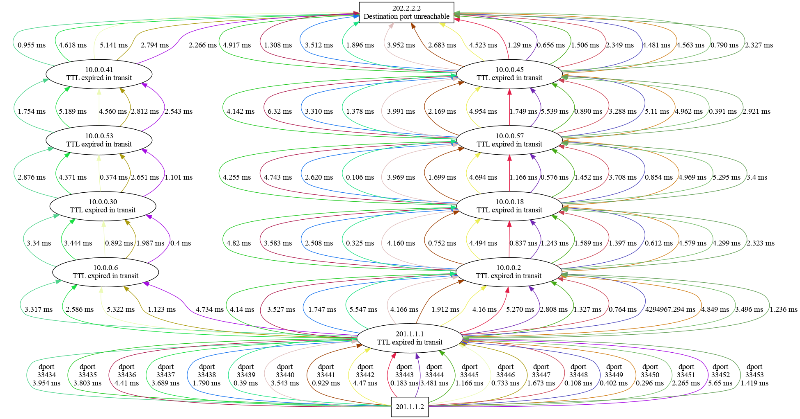
dublin-traceroute example output

Slide 70
bibliography and further readings
[Caiazzi ‘22] Caiazzi, Scazzariello, Alberro, Ariemma, Castro, Grampin, Di Battista, “Sibyl: a Framework for Evaluating the Implementation of Routing Protocols in Fat-Trees“, NOMS 2022
[Caiazzi ‘21] Caiazzi, Scazzariello, Ariemma, “VFTGen: a Tool to Perform Experiments in Virtual Fat Tree Topologies“, IM 2021
[Caiazzi ‘19] Caiazzi, “Software Defined Data Centers: methods and tools for routing protocol verification and comparison”, Ms. Thesis, Roma Tre University, 2019
[Dutt ‘17] Dutt, “BGP in the Data Center”, O’Reilly, 2017
[RFC-7938] Lapukhov, Premji, “Use of BGP for Routing in Large-Scale Data Centers” Internet Engineering Task Force (IETF) Request for Comments: 7938

Slide 71
how to handle multiple tenants?
again, why BGP?

Slide 72
overview – multiple tenants
requirements
servers’ architecture requirements
orchestration requirements
tenant requirements
tunneling protocols
VXLAN
EVPN-BGP

Slide 73
servers' architecture requirements
having services directly on bare metal is not used
too many physical servers needed
no way to scale if more resources are requested
no isolation between different services on the same server
support a virtual layer of containers or VMs
high-availability guaranteed via orchestration
useful for resource-slicing
complete isolation between different containers or VMs on the same server
possibility to assign containers or VMs to different tenants

Slide 74
orchestration requirements
an orchestrator is a software that manages the lifecycle of containers/VMs
creates, moves, and destroys containers/VMs
needed for
optimal resource allocation, handling failures, management
when moving a container/VM
possibility to keep network configurations (MAC/IP)
minimal downtime

Slide 75
tenant requirements
each tenant wants to independently manage its own private IP address space
containers/VMs traffic must be segregated between tenants and between the data center traffic

Slide 76
consequence of requirements
server, orchestration, and tenant requirements have a consequence
usage of tunnels

Slide 77
tunneling protocol requirements
minimal configuration
encapsulate the traffic of each tenant
an identifier of the tenant is needed
encapsulation in Layer-4
to fully exploit IP Multi-Path
to traverse routers
data center fabric is Layer-3
to traverse Internet
different data centers must interconnect via Internet transparently (to create the so called regions)

Slide 78
possible choices for tunneling
VLAN
can be used only in L2, the data center is L3
MPLS
each router must be configured for each new tenant
traversing Internet requires ISP to configure intermediate routers
VXLAN
created ad-hoc ☺

Slide 79
VXLAN
Virtual eXtensible Local Area Network (RFC-7348)
designed to address the need for overlay networks within virtualized data centers accommodating multiple tenants
encapsulates Layer-2 frames into UDP packets

Slide 80
VXLAN terminology
VNI: VXLAN Network Identifier
identifier of a specific VXLAN tunnel
similar to the VLAN ID
24 bit address space, more than 16M possible VNIs
VTEP: VXLAN Tunnel End Point
device (physical or virtual) that encapsulates and decapsulates VXLAN packets

Slide 81
VXLAN encapsulation
overhead of 50 bytes
random Source Port to fully exploit Multi-Path

Slide 82
MAC-to-VTEP Table
hosted in each VTEP
similar to the switch forwarding table
for each VNI the VTEP keeps a table of pairs <mac,ip>, that associates MAC Addresses and destination VTEP IPs
each physical (or VLAN) L2 interface of a VTEP is assigned to a VNI
the MAC addresses learned on such interfaces are local, and the IPs of their pairs is replaced by the word local

Slide 83
MAC-to-VTEP Table
when a VTEP receives a frame destinated to a MAC Address m from a local interface belonging to a certain VNI, it checks for the existence (in the VNI) of a pair <m,i> containing m
if the pair exists, the VTEP encapsulates the frame, and sends the resulting packet to the destination VTEP IP i
if not, the frame is sent to all the other VTEPs (encapsulated) and to all the local ports of that VNI

Slide 84
VXLAN transport
0:A 100 local
0:B 100 193.204.0.2
0:B 100 local
0:A 100 193.204.0.1
.1
0:A
.2
0:B
.1
193.204.0.0/15
.2
10.0.0.0/24
10.0.0.0/24
Host 1
VTEP
VTEP
Host 2
L2 Packets
VXLAN Packets, VNI 100
L2 Packets

Slide 85
how to handle broadcast traffic
two types of broadcast must be handled
traffic directed to the MAC broadcast address
e.g., ARP traffic
traffic directed to a MAC address that has not been learned
IP multicast groups are used by default
each VNI is assigned to an IP multicast group of the underlay network and each VTEP subscribes itself to each group of its VNIs
the multicast group of a VNI is used only to send the broadcast traffic

Slide 86
disadvantages of multicast and alternatives
multicast must be enabled in the underlay network
it may require to deploy several protocols
e.g., IGMP, IGMP Snooping, PIM, ….
complex configuration
if multicast is not enabled, broadcast frames are duplicated and sent unicast to all the VTEPs of the VNI
proxy ARP techniques can be used to mitigate broadcast traffic

Slide 87
EVPN-BGP
Ethernet VPN (RFC-7432 and RFC-8365)
uses MP-BGP with specific AFI/SAFI
Address Family Identifier/Subsequent AFI
AFI=25 (L2VPN) – SAFI=70 (EVPN)
advertises MAC Addresses of VNIs using BGP updates
a VTEP automatically learns local MAC Addresses and advertises them to all other VTEPs (of the same VNI)
VTEP proxies ARP requests to limit broadcast traffic

Slide 88
VXLAN and EVPN-BGP transport
0:A 100 local
0:B 100 193.204.0.2
0:A 100 local
0:A 100 193.204.0.1
0:B 100 local
0:A 100 193.204.0.1
.2
0:B
.1
0:A
0:B
0:A
.1
193.204.0.0/15
.2
10.0.0.0/24
10.0.0.0/24
eBGP multihop peering
VTEP
VTEP
Host 1
(+ BGP Router)
(+ BGP Router)
Host 2
0:B 100 193.204.0.2
0:A 100 193.204.0.1

Slide 89
VXLAN and EVPN-BGP Lab
time to use Kathará

Slide 90
topology
.1
.2
.1
.2
A
vtep1
B
vtep2
C
s1
s2
10.0.0.0/24
193.204.0.0/30
10.0.0.0/24

Slide 91
lab base config – topology, s1, and s2
lab.conf
s1[0]=A
vtep1[0]=A
vtep1[1]=B
vtep2[0]=C
vtep2[1]=B
s2[0]=C
s1.startup
s2.startup
ifconfig eth0 10.0.0.1/24 up
ip link set dev eth0 mtu 1450
/etc/init.d/apache2 start
ifconfig eth0 10.0.0.2/24 up
ip link set dev eth0 mtu 1450
/etc/init.d/apache2 start

Slide 92
MTU
need to set manual MTU of each device’s interface associated to a VNI
when a frame is encapsulated by a VTEP, if its size is greater than 1450 (LAN MTU – VXLAN overhead)
the frame is dropped
an ICMP “packet too big” message is sent back

Slide 93
configuring a bridge/router with VTEPs
we need to configure a Kathara device that is able to:
act as a bridge on L2 ports
able to perform L2 learning
act as a router on the ports on the underlay networks
able to establish BGP peerings
able to encapsulate/decapsulate VXLAN traffic

Slide 94
VTEP configuration
create bridge facilities (aka companion bridges)
one virtual bridge with ports assigned to VLANs corresponding to VNIs
attach the collision domains associated to a VNI to the companion bridge of that VNI
configure the base BGP peerings
enable the AFI/SAFI of EVPN
configure VXLAN

Slide 95
vtep e-BGP configuration
vtep1/etc/frr/bgpd.conf
vtep2/etc/frr/bgpd.conf
router bgp 1
neighbor 193.204.0.2 remote-as 2
address-family l2vpn evpn
neighbor 193.204.0.2 activate
advertise-all-vni
exit-address-family
router bgp 2
neighbor 193.204.0.1 remote-as 1
address-family l2vpn evpn
neighbor 193.204.0.1 activate
advertise-all-vni
exit-address-family
activate the address-family on the peering with specific neighbor
announce on the peerings all the VNIs configured in the VTEP

Slide 96
companion bridge
the bridge connected to VTEP interfaces
used by the VTEP to perform source address learning of local interfaces
when in combination with EVPN-BGP
its forwarding table is also populated via updates received from BGP
the FRR control plane watch to updates of the bridge forwarding table to send updates via BGP

Slide 97
vtep1 bridge configuration
vtep1.startup
ifconfig eth1 193.204.0.1/30 up
# Setting up VXLAN interfaces
ip link add vtep100 type vxlan id 100 dev eth1 dstport 4789 local 193.204.0.1 nolearning
ip link set up dev vtep100
# Creating the companion bridge
ip link add br100 type bridge
# Attach interfaces to the bridge
ip link set dev vtep100 master br100
ip link set dev eth0 master br100
# Enable bridge vlans
ip link set dev br100 type bridge vlan_filtering 1
bridge vlan add vid 100 dev vtep100 pvid untagged
bridge vlan add vid 100 dev eth0 pvid untagged
ip link set up dev br100
# Enabling FRR
/etc/init.d/frr start
create the companion bridge and name it
VNI
VXLAN dst port
attach the VXLAN interface to the bridge
name of the interface
VXLAN src IP
enable the VXLAN interface
attach eth0 (the server s1 collision domain) to the bridge
interface used to send VXLAN packets into the underlay network
disable the mcast learning
create the interface
enable VLANs on the bridge
enable the bridge
configure VLANs on bridge ports

Slide 98
vtep2 bridge configuration
vtep2.startup
ifconfig eth1 193.204.0.2/30 up
# Setting up VXLAN interfaces
ip link add vtep100 type vxlan id 100 dev eth1 dstport 4789 local 193.204.0.2 nolearning
ip link set up dev vtep100
# Creating the companion bridge
ip link add br100 type bridge
# Attach interfaces to the bridge
ip link set dev vtep100 master br100
ip link set dev eth0 master br100
# Enable bridge vlans
ip link set dev br100 type bridge vlan_filtering 1
bridge vlan add vid 100 dev vtep100 pvid untagged
bridge vlan add vid 100 dev eth0 pvid untagged ip link set up dev br100
# Enabling FRR
/etc/init.d/frr start

Slide 99
the EVPN-BGP control-plane
vtep1# show evpn mac vni all
VNI 100 #MACs (local and remote) 2
Flags: N=sync-neighs, I=local-inactive, P=peer-active, X=peer-proxy
MAC Type Flags Intf/Remote ES/VTEP VLAN Seq #'s
a2:6d:75:c7:06:6f remote 193.204.0.2 0/0
c2:93:31:36:31:b6 local eth0 0/0

Slide 100
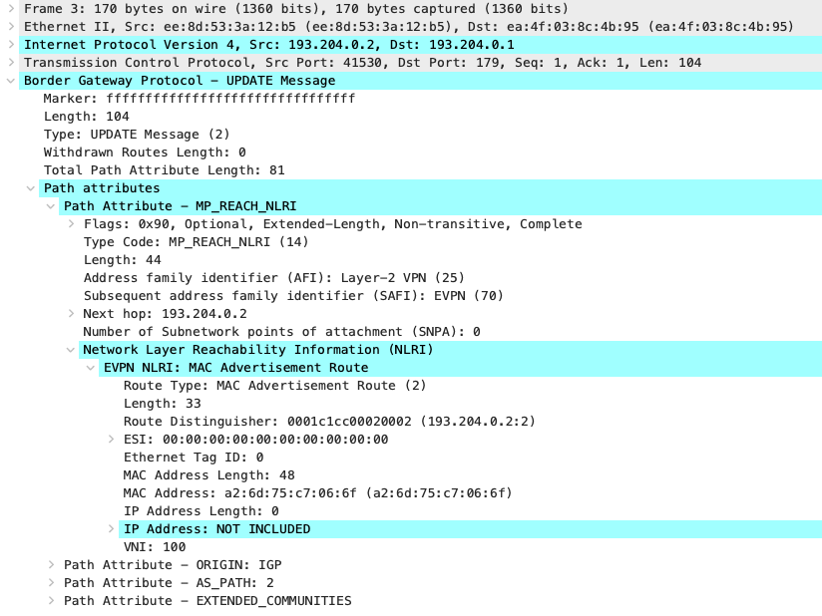
a BGP update
from vtep2 to vtep1
announcement
AFI/SAFI of l2vpn/EVPN
VTEP destination
MAC address of s1
VNI of s1

Slide 101
VXLAN encapsulation
overhead of 50 bytes
random Source Port to fully exploit Multi-Path

Slide 102
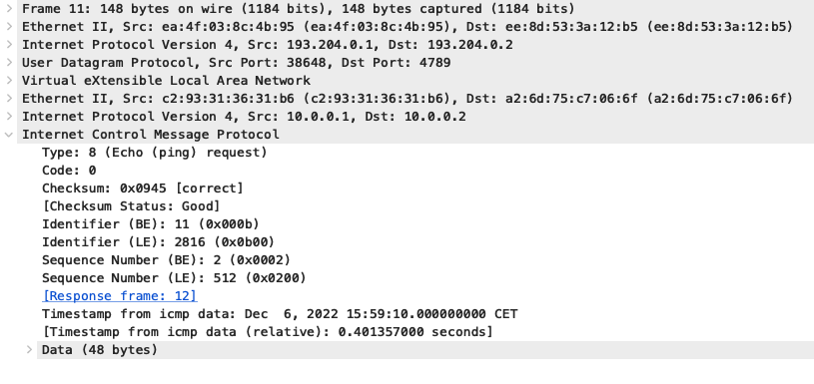
a PING packet encapsulated in VXLAN
MAC addresses of vtep1 and vtep2
Outer Layer 1
Outer MAC Header
IPs of VTEPs
Outer IP Layer
MAC addresses of s1 and s2
Outer UDP Header
VXLAN Header
IPs of servers
Original Layer 2
Original Layer 3
Original ICMP Packet

Slide 103

putting together
(EVPN-)BGP

Slide 104
overview
containers or VMs of different tenants
where is the VTEP?
the Leaf-server links
inside the servers
dual attached servers
a complete lab experience

Slide 105
servers in the fabric – recap
Servers
Containers or VMs

Slide 106
containers or VMs of different tenants
different colours represent different tenants

Slide 107
EVPN-BGP – where is the VTEP?
containers must be unaware of tunneling
different choices for positioning the VTEP
in each server
the server should have a BGP peering for enabling EVPN-BGP
the server CPU would be used to route packets
in each Leaf
a Leaf already has a BGP peering
a Leaf is a router, so it has dedicated routing hardware
usage of VLANs in the link connecting a Leaf and a server to distinguish tenants

Slide 108
inside the Leaves
VLANs are used
mapping between VNIs and VLAN IDs
tenants are unaware of the mapping
Leaves decapsulate VXLAN received packets and encapsulate them into VLAN frames, according to the mapping
and vice-versa

Slide 109
inside the servers
the server uses the VLAN IDs to forward packets to the correct containers/VMs
the server untags the packets so that the containers/VMs are unaware of the VLANs
containers/VMs of the same tenant share the same virtual Layer-2 network

Slide 110
deploying VXLAN
VLAN ID VNI
10 5010
20 5020
… …
VLAN ID Container
10 1_1_1
20 1_1_3
… …
VXLAN
VLAN
no encapsulation

Slide 111
the last problem to overcome
if a Leaf-server link breaks down, the server is severed off the data center
if a Leaf breaks, all the servers connected to that Leaf are severed off the data center
if a maintenance needs to be done on a Leaf, all the servers connected to that Leaf are temporarily severed off the data center

Slide 112
dual attached servers – bonding
aggregates multiple NICs into a single virtual interface
Layer-2 technology
different policies are possible
active-backup
active-active
balance-rr
balance-xor
802.3ad
and more…

Slide 113
the full picture
VLAN ID VNI
10 5010
20 5020
… …
VLAN ID Container
10 1_1_1
20 1_1_3
… …
VXLAN
VLAN
no encapsulation

Slide 114
EVPN-BGP Fat-Tree lab
hands on Kathará

Slide 115
anycast BGP
technique that allows different devices to share the same IP address
often used in the Internet with DNS servers and CDN servers
BGP chooses among the nearest instance of the IP address
in the data center, multipath is exploit to balance over multiple instances of the same anycast IPs

Slide 116
lab topology
10.0.0.28/30
10.0.0.48/30
10.0.0.24/30
10.0.0.52/30
AS64518
10.0.0.20/30
tof_1_2_1
tof_1_2_2
10.0.0.56/30
10.0.0.16/30
10.0.0.60/30
G
H
I
Q
R
S
T
J
AS64514
AS64517
10.0.0.12/30
spine_1_1_1
spine_1_1_2
spine_2_1_1
spine_2_1_2
D
B
10.0.0.4/30
10.0.0.44/30
N
L
10.0.0.36/30
10.0.0.0/30
A
E
10.0.0.8/30
10.0.0.32/30
K
O
10.0.0.40/30
AS64512
AS64513
AS64515
AS64516
VNI: 5010, VLAN ID 10
Prefix: 200.10.0.0/16
leaf_1_0_1
leaf_1_0_2
leaf_2_0_1
leaf_2_0_2
C
U
V
Z
M
F
P
W
VNI: 5020, VLAN ID 20
Prefix: 200.20.0.0/16
lo: 192.168.0.1/32
lo: 192.168.0.2/32
server_1_1
server_1_2
server_2_1
server_2_2
VNI: 5030, VLAN ID 30
Prefix: 200.30.0.0/16
AA
AB
AC
AD
AE
AF
1_1_1
1_1_2
1_1_3
1_2_1
1_2_2
2_1_1
2_2_1
.0.1
.0.2
.0.1
.0.1
.0.2
.0.2
.0.3

Slide 117
leaf configuration example – part 1
leaf_1_0_1.startup
ifconfig eth0 10.0.0.1/30 up
ifconfig eth1 10.0.0.5/30 up
# Create loopback
ip addr add 192.168.0.1/32 dev lo
route add 192.168.0.1/32 dev lo
# Setting up VXLAN interfaces
ip link add vtep5010 type vxlan id 5010 dev lo dstport 4789 local 192.168.0.1 nolearning
ip link set up dev vtep5010
ip link add vtep5020 type vxlan id 5020 dev lo dstport 4789 local 192.168.0.1 nolearning
ip link set up dev vtep5020
ip link add vtep5030 type vxlan id 5030 dev lo dstport 4789 local 192.168.0.1 nolearning
ip link set up dev vtep5030
configure an anycast IP address on the loopback interface
set source IP for the VTEPs to be the loopback IP

Slide 118
leaf configuration example – part 2
leaf_1_0_1.startup – part 2
ip link add bond2 type bond miimon 100 mode 802.3ad
ip link set down dev eth2
ip link set dev eth2 master bond2
ip link set up dev eth2
ip link set up dev bond2
ip link add bond3 type bond miimon 100 mode 802.3ad
ip link set down dev eth3
ip link set dev eth3 master bond3
ip link set up dev eth3
ip link set up dev bond3
# Creating the companion bridge
ip link add br100 type bridge
create the bond interface
disable interfaces
connect physical interfaces to the bond
enable the interfaces

Slide 119
leaf configuration example – part 3
leaf_1_0_1.startup – part 3
# Attach interfaces to the bridge
ip link set dev vtep5010 master br100
ip link set dev vtep5020 master br100
ip link set dev vtep5030 master br100
ip link set dev eth2 master br100
ip link set dev eth3 master br100
# Enable bridge vlans
ip link set dev br100 type bridge vlan_filtering 1
bridge vlan add vid 10 dev vtep5010 pvid untagged
bridge vlan add vid 20 dev vtep5020 pvid untagged
bridge vlan add vid 30 dev vtep5030 pvid untagged
bridge vlan add vid 10 dev eth2
bridge vlan add vid 20 dev eth2
bridge vlan add vid 20 dev eth3
bridge vlan add vid 30 dev eth3
ip link set up dev br100
/etc/init.d/frr start
enable VLANs on the bridge
configure the vtep ports to receive/send untagged traffic of specific VLANs
configure the server ports to receive/send VLAN tagged traffic of specific VLANs

Slide 120
leaf BGP configuration example
bgpd.conf - part 1
bgpd.conf - part 2
hostname frr
password frr
enable password frr
router bgp 64512
timers bgp 3 9
bgp router-id 192.168.0.1
no bgp ebgp-requires-policy
bgp bestpath as-path multipath-relax
neighbor TOR peer-group
neighbor TOR remote-as external
neighbor TOR advertisement-interval 0
neighbor TOR timers connect 10
neighbor eth0 interface peer-group TOR
neighbor eth1 interface peer-group TOR
address-family ipv4 unicast
neighbor TOR activate
redistribute connected route-map LOOPBACKS
maximum-paths 64
exit-address-family
address-family l2vpn evpn
neighbor TOR activate
advertise-all-vni
exit-address-family
route-map LOOPBACKS permit 10
match interface lo
enable the l2vpn evpn AFI/SAFI A.F.
route-map to announce the loopback IP

Slide 121
spine BGP configuration example
bgpd.conf - part 1
bgpd.conf - part 2
hostname frr
password frr
enable password frr
router bgp 64514
timers bgp 3 9
bgp router-id 192.168.0.5
no bgp ebgp-requires-policy
bgp bestpath as-path multipath-relax
neighbor TOR peer-group
neighbor TOR remote-as external
neighbor TOR advertisement-interval 0
neighbor TOR timers connect 10
neighbor eth0 interface peer-group TOR
neighbor eth1 interface peer-group TOR
neighbor fabric peer-group
neighbor fabric remote-as external
neighbor fabric advertisement-interval 0
neighbor fabric timers connect 10
neighbor eth2 interface peer-group fabric
neighbor eth3 interface peer-group fabric
address-family ipv4 unicast
neighbor fabric activate
neighbor TOR activate
maximum-paths 64
exit-address-family
address-family l2vpn evpn
neighbor fabric activate
neighbor TOR activate
exit-address-family
activate the l2vpn evpn AFI/SAFI A.F.

Slide 122
ToF BGP configuration example
bgpd.conf - part 1
bgpd.conf - part 2
hostname frr
password frr
enable password frr
router bgp 64518
timers bgp 3 9
bgp router-id 192.168.0.13
no bgp ebgp-requires-policy
bgp bestpath as-path multipath-relax
neighbor fabric peer-group
neighbor fabric remote-as external
neighbor fabric advertisement-interval 0
neighbor fabric timers connect 10
neighbor eth0 interface peer-group fabric
neighbor eth1 interface peer-group fabric
neighbor eth2 interface peer-group fabric
neighbor eth3 interface peer-group fabric
address-family ipv4 unicast
neighbor fabric activate
maximum-paths 64
exit-address-family
address-family l2vpn evpn
neighbor fabric activate
exit-address-family
activate the l2vpn evpn AFI/SAFI A.F.

Slide 123
server configuration example – part 1
server_1_1.startup
ip link add bond1 type bond miimon 100 mode 802.3ad xmit_hash_policy layer3+4 all_slaves_active 1
ip link set dev eth0 down
ip link set dev eth1 down
ip link set dev bond1 down
ip link set eth0 master bond1
ip link set eth1 master bond1
ip link set dev eth0 up
ip link set dev eth1 up
ip link set dev bond1 up
# Creating the bridge
ip link add br100 type bridge
# Attach interfaces to the bridge
ip link set dev bond1 master br100
ip link set dev eth2 master br100
ip link set dev eth3 master br100
create the bond interface
disable interfaces
connect physical interfaces to the bond
enable the interfaces
create the bridge
connect the bond and container interfaces to the bridge

Slide 124
why 802.3ad with active-backup?
usually the right policy is active-active with hash policy
to support dual attached servers in active-active mode to different switches (leaves), Multi-Chassis Link Aggregation (MLAG) is needed
MLAG enables a server or switch with a two-port bond, to connect those ports to different switches and operate as if they are connected to a single, logical switch. This provides greater redundancy and greater system throughput.
classic Linux kernels do not support MLAG

Slide 125
server configuration example – part 2
server_1_1.startup
# Enable bridge vlans
ip link set dev br100 type bridge vlan_filtering 1
bridge vlan add vid 10 dev bond1
bridge vlan add vid 20 dev bond1
bridge vlan add vid 10 dev eth2 pvid untagged
bridge vlan add vid 20 dev eth3 pvid untagged
ip link set up dev br100
configure the bond port of the bridge to receive tagged VLAN packets
configure the container ports to send untagged frames

Slide 126
a leaf data plane
root@leaf_1_0_1:/# ip route
10.0.0.0/30 dev eth0 proto kernel scope link src 10.0.0.1
10.0.0.4/30 dev eth1 proto kernel scope link src 10.0.0.5
192.168.0.1 dev lo scope link
192.168.0.7 nhid 10 proto bgp metric 20
nexthop via 10.0.0.2 dev eth0 weight 1
nexthop via 10.0.0.6 dev eth1 weight 1

Slide 127
a leaf BGP control plane
leaf_1_1_1# show ip bgp
BGP table version is 2, local router ID is 192.168.0.1, vrf id 0
Default local pref 100, local AS 64512
Status codes: s suppressed, d damped, h history, * valid, > best, = multipath,
i internal, r RIB-failure, S Stale, R Removed
Nexthop codes: @NNN nexthop's vrf id, < announce-nh-self
Origin codes: i - IGP, e - EGP, ? - incomplete
Network Next Hop Metric LocPrf Weight Path
*> 192.168.0.1/32 0.0.0.0 0 32768 i
*> 192.168.0.7/32 10.0.0.2 0 64514 64518 64517 64515 i
*= 10.0.0.6 0 64514 64518 64517 64515 i

Slide 128
a leaf EVPN control plane
leaf_1_1_1# show evpn mac vni 5010
Number of MACs (local and remote) known for this VNI: 3
Flags: N=sync-neighs, I=local-inactive, P=peer-active, X=peer-proxy
MAC Type Flags Intf/Remote ES/VTEP VLAN Seq #'s
8e:cf:26:1f:44:16 local eth2 10 0/0
d2:23:78:4a:e9:02 local eth2 10 0/0
76:76:b2:f0:18:6d remote 192.168.0.7 0/0

Slide 129
bibliography and further readings
[Dutt ‘18] Dutt, “EVPN in the Data Center”, O’Reilly, 2018
[Bernat ‘17] Bernat, “VXLAN: BGP EVPN with FRR“, https://vincent.bernat.ch/en/blog/2017-vxlan-bgp-evpn
[Bernat ‘17] Bernat, “VXLAN & Linux”, https://vincent.bernat.ch/en/blog/2017-vxlan-linux
[RFC-7432] Sajassi, Aggarwal, Bitar, Isaac, Uttaro, Drake, Henderickx, “BGP MPLS-Based Ethernet VPN ” Internet Engineering Task Force (IETF) Request for Comments: 7432
[RFC-8365] Sajassi, Drake, Bitar, Shekhar, Uttaro, Henderickx, “A Network Virtualization Overlay Solution Using Ethernet VPN (EVPN)” Internet Engineering Task Force (IETF) Request for Comments: 8365

